Slide 1





Machine learning-based prediction of cognitive outcomes in de novo Parkinson’s disease Rick Reijnders
Harvey, J., Reijnders, R.A., Cavill, R. et al. Machine learning-based prediction of cognitive outcomes in de novo Parkinson’s disease. npj Parkinsons Dis. 8, 150 (2022). https://doi.org/10.1038/s41531-022-00409-5

Slide 2

Background
Parkinson’s Disease (PD)
Cognitive impairment and Dementia
Prevalence
Underdiagnosed
Predictive measures
Challenges
Solutions
Machine learning
Notes:
brain disorder
causes unintended or uncontrollable movements
such as shaking, stiffness, and difficulty with balance and coordination.
Symptoms begin gradually and worsen over time.
As disease progresses, people difficulty walking and talking.

Slide 3
Background
Parkinson’s Disease (PD)
Cognitive impairment and Dementia
Prevalence
Underdiagnosed
Predictive measures
Challenges
Solutions
Machine learning
Distinct diagnostic challenges
Higher burden of care
Worse functioning
Lower quality of life
Notes:
CI and Dementia are debilitating non- motor symptoms of PD
Ci holds
distinct diagnostic challenges
Higher burden of care
worse functioning
lower quality of life

Slide 4
Background
Parkinson’s Disease (PD)
Cognitive impairment and Dementia
Prevalence
Underdiagnosed
Predictive measures
Challenges
Solutions
Machine learning
30% of PD patients show Dementia
20% mild levels of cognitive impairment
50% of PD patients develop Dementia
Notes:
Cross sect Studies show ~30% in PD have Dementia
with 20-25 % mild levels of cognitive impairment (MCI), as early as diagnosis
Longitudinal studies indicate an Average of 50% of PD patients develop dementia within 10 years

Slide 5
Background
Parkinson’s Disease (PD)
Cognitive impairment and Dementia
Prevalence
Underdiagnosed
Predictive measures
Challenges
Solutions
Machine learning
Complexity
Multi-domain nature of cognitive dysfunction
Notes:
Despite the high prevalence, it is underdiagnosed in most clinical settings
Partially due to
the complexity
and the multi-domain nature of cognitive dysfucnt

Slide 6
Background
Parkinson’s Disease (PD)
Cognitive impairment and Dementia
Prevalence
Underdiagnosed
Predictive measures
Challenges
Solutions
Machine learning
Age, Hallucinations, REM sleep disorder, severity of Parkinsonism
Notes:
However, some demographic and clinical measures are predictive in PD-cognitive impairment
Such as:
age
Hallucinations
REM sleep disorder
Severity of parkinsonism -> non-tremor symptoms
There is considerable research interest in identifying objective biomarkers, including structural and functional imaging, biofluid measures and genetic risk.

Slide 7
Background
Parkinson’s Disease (PD)
Cognitive impairment and Dementia
Prevalence
Underdiagnosed
Predictive measures
Challenges
Solutions
Machine learning
Clinical presentation and progression
Notes:
Even though there are some predictive measures, there are some challenges in predicting cognitive outcome in PD
High heterogeneity within condition
High interindividual variation
due to clinical presentation and progression

Slide 8
Background
Parkinson’s Disease (PD)
Cognitive impairment and Dementia
Prevalence
Underdiagnosed
Predictive measures
Challenges
Solutions
Machine learning
Multivariate panels
Complexity of multi-modal data
Notes:
A potential solution is using algorithms that combine multiple measures,
however
Employing multivariate panels of data, comes with limitations implicit in the complexity of multi-modal data

Slide 9
Background
Parkinson’s Disease (PD)
Cognitive impairment and Dementia
Prevalence
Underdiagnosed
Predictive measures
Challenges
Solutions
Machine learning
High-dimensional and complex data
Notes:
Compared to classical statistical methodology, learning-based methods benefit
from being able to
process high-dimensional and complex data,
finding both linear and nonlinear associations
extracting meaningful variables of interest
As such, this is a growing area of reseach focusing on
Identifying data-driven subtypes of disease
predict disease progression
future cognitive outcomes

Slide 10
Goals
Parkinson's Progression Markers Initiative (PPMI)
Outcomes
Cognitive impairment
Dementia
8-year time period, baseline (early PD)
Aim
Establish powerful multivariate predictive models
Highlight important predictive variables
Notes:
We assessed longitudinal records of cognitive diagnoses in the Parkinson’s Progression Markers Initiative (PPMI)
well-characterized cohort of early PD patients
used multiple ML methods to predict cognitive outcome using baseline variables.

Slide 11
Goals
Parkinson’s Progression Markers Initiative (PPMI)
Outcomes
Cognitive impairment
Dementia
8-year time period, baseline (early PD)
Aim
Establish powerful multivariate predictive models
Highlight important predictive variables
Notes:
We assessed prediction of two outcome measures over an 8-year time period:
(i) development of cognitive impairment (MCI or dementia)
(ii) development of dementia.

Slide 12
Goals
Parkinson’s Progression Markers Initiative (PPMI)
Outcomes
Cognitive impairment
Dementia
8-year time period, baseline (early PD)
Aim
Establish powerful multivariate predictive models
Highlight important predictive variables

Slide 13
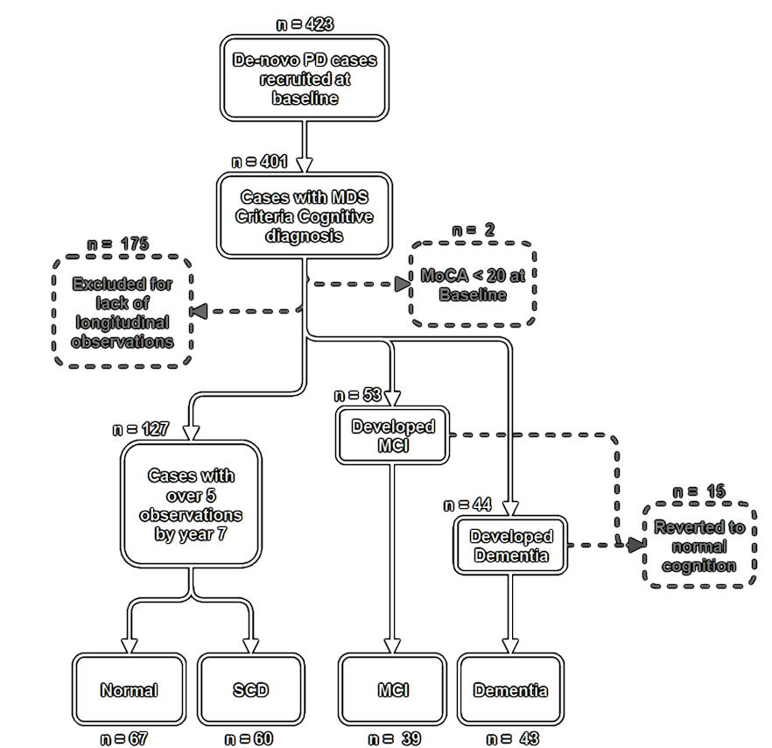
Subsetting cognitive outcome groups

Slide 14
Subsetting cognitive outcome groups
Cognitive impairment outcome
Development of overall cognitive impairment in 8 years
MCI + Dementia vs Normal + SCD
n = 82
n = 127
Normal
SCD
MCI
Dementia

Slide 15
Subsetting cognitive outcome groups
Cognitive impairment outcome
Development of overall cognitive impairment in 8 years
MCI + Dementia vs Normal + SCD
n = 82
n = 127
Dementia outcome
Dementia development in 8 years
Dementia vs Normal + SCD + MCI
n = 43
n = 166
Normal
SCD
MCI
Dementia

Slide 16

Curating Baseline Measures
Clinical
Demographic:
Age, Sex, Years of
Education, Ethnicity,
Family History
Psychiatric:
Geriatric Depression,
State Trait Anxiety
Motor:
TD/ PIGD Subtype,
H&Y, MDS-UPDRS III,
Schwab & England ADL
Other:
UPSIT Olfactory,
Epworth Sleepiness,
QUIP Impulse,
REM- Sleep Behavior
Disorder, SCOPA-Autonomic
Cognitive:
MDS-UPDRS I, BJLO,
HVLT, LNS, Semantic
Fluency, MOCA, SDM
Notes:
BASELINE

Slide 17

Curating Baseline Measures
Clinical
Demographic:
Age, Sex, Years of
Education, Ethnicity,
Family History
Psychiatric:
Geriatric Depression,
State Trait Anxiety
Motor:
TD/ PIGD Subtype,
H&Y, MDS-UPDRS III,
Schwab & England ADL
Other:
UPSIT Olfactory,
Epworth Sleepiness,
QUIP Impulse,
REM- Sleep Behavior
Disorder, SCOPA-Autonomic
Cognitive:
MDS-UPDRS I, BJLO,
HVLT, LNS, Semantic
Fluency, MOCA, SDM
Biofluid
CSF:
A-beta 1-42
Alpha-synuclein
Total-tau
Phospho-tau
Blood:
Urate

Slide 18

Curating Baseline Measures
Clinical
Demographic:
Age, Sex, Years of
Education, Ethnicity,
Family History
Psychiatric:
Geriatric Depression,
State Trait Anxiety
Motor:
TD/ PIGD Subtype,
H&Y, MDS-UPDRS III,
Schwab & England ADL
Other:
UPSIT Olfactory,
Epworth Sleepiness,
QUIP Impulse,
REM- Sleep Behavior
Disorder, SCOPA-Autonomic
Cognitive:
MDS-UPDRS I, BJLO,
HVLT, LNS, Semantic
Fluency, MOCA, SDM
Biofluid
CSF:
A-beta 1-42
Alpha-synuclein
Total-tau
Phospho-tau
Blood:
Urate
Risk genotypes:
APO-E
SNCA
GBA
MAPT
Polygenic Scores:
Alzheimer’s Disease
PD
Schizophrenia
Depression
Coronary Artery Disease
Educational Attainment
Epigenetic:
21 DNA methylation values
4 Age Acceleration Measures
Smoking Score
(Epi)genetic

Slide 19
Workflow
Classes
Cognitive impairment outcome
Dementia outcome
4 feature subsets
Genetic/Epigenetic
Biofluids
Clinical
All (combined)

Slide 20
Workflow
Classes
Cognitive impairment outcome
Dementia outcome
4 feature subsets
Genetic/Epigenetic
Biofluids
Clinical
All (combined)

Slide 21
Workflow
Classes
Cognitive impairment outcome
Dementia outcome
4 feature subsets
Genetic/Epigenetic
Biofluids
Clinical
All (combined)
4 ML algorithms
Conditional Inference Random Forest (Cforest)
Support vector machines with linear kernel (Svmlinear)
L1 and L2 regularized regression (Elasticnet)
Random forest (RF)

Slide 22
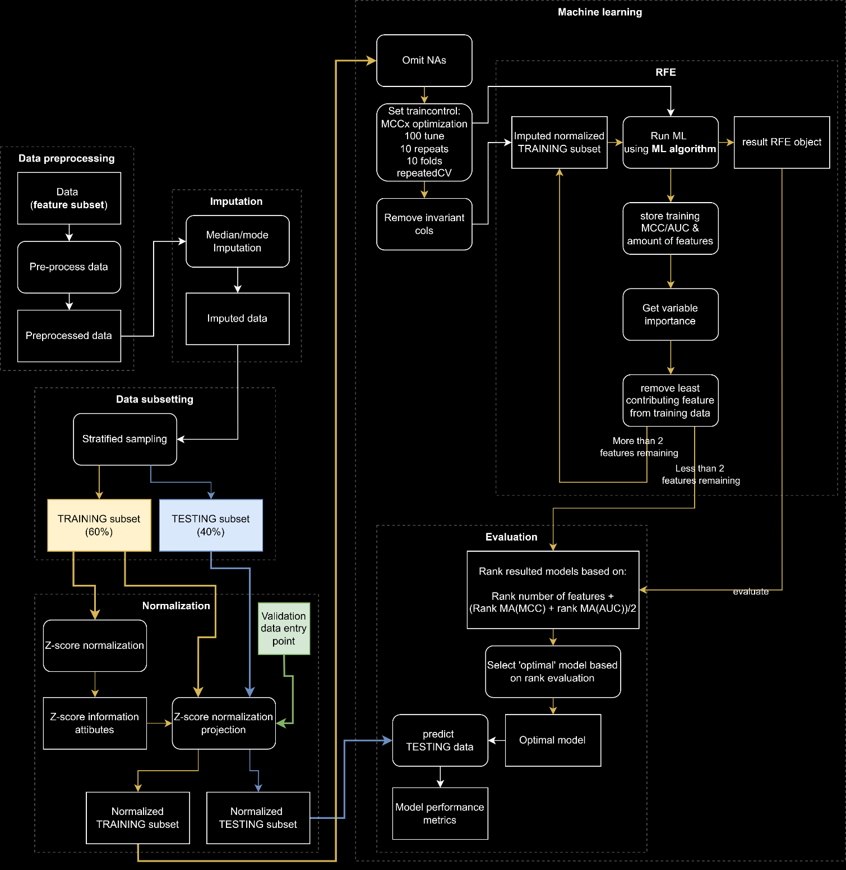
Workflow
Data preprocessing
Imputation
Data subsetting
Normalization
Machine learning
RFE
Evaluation
Notes:
ML workflow

Slide 23
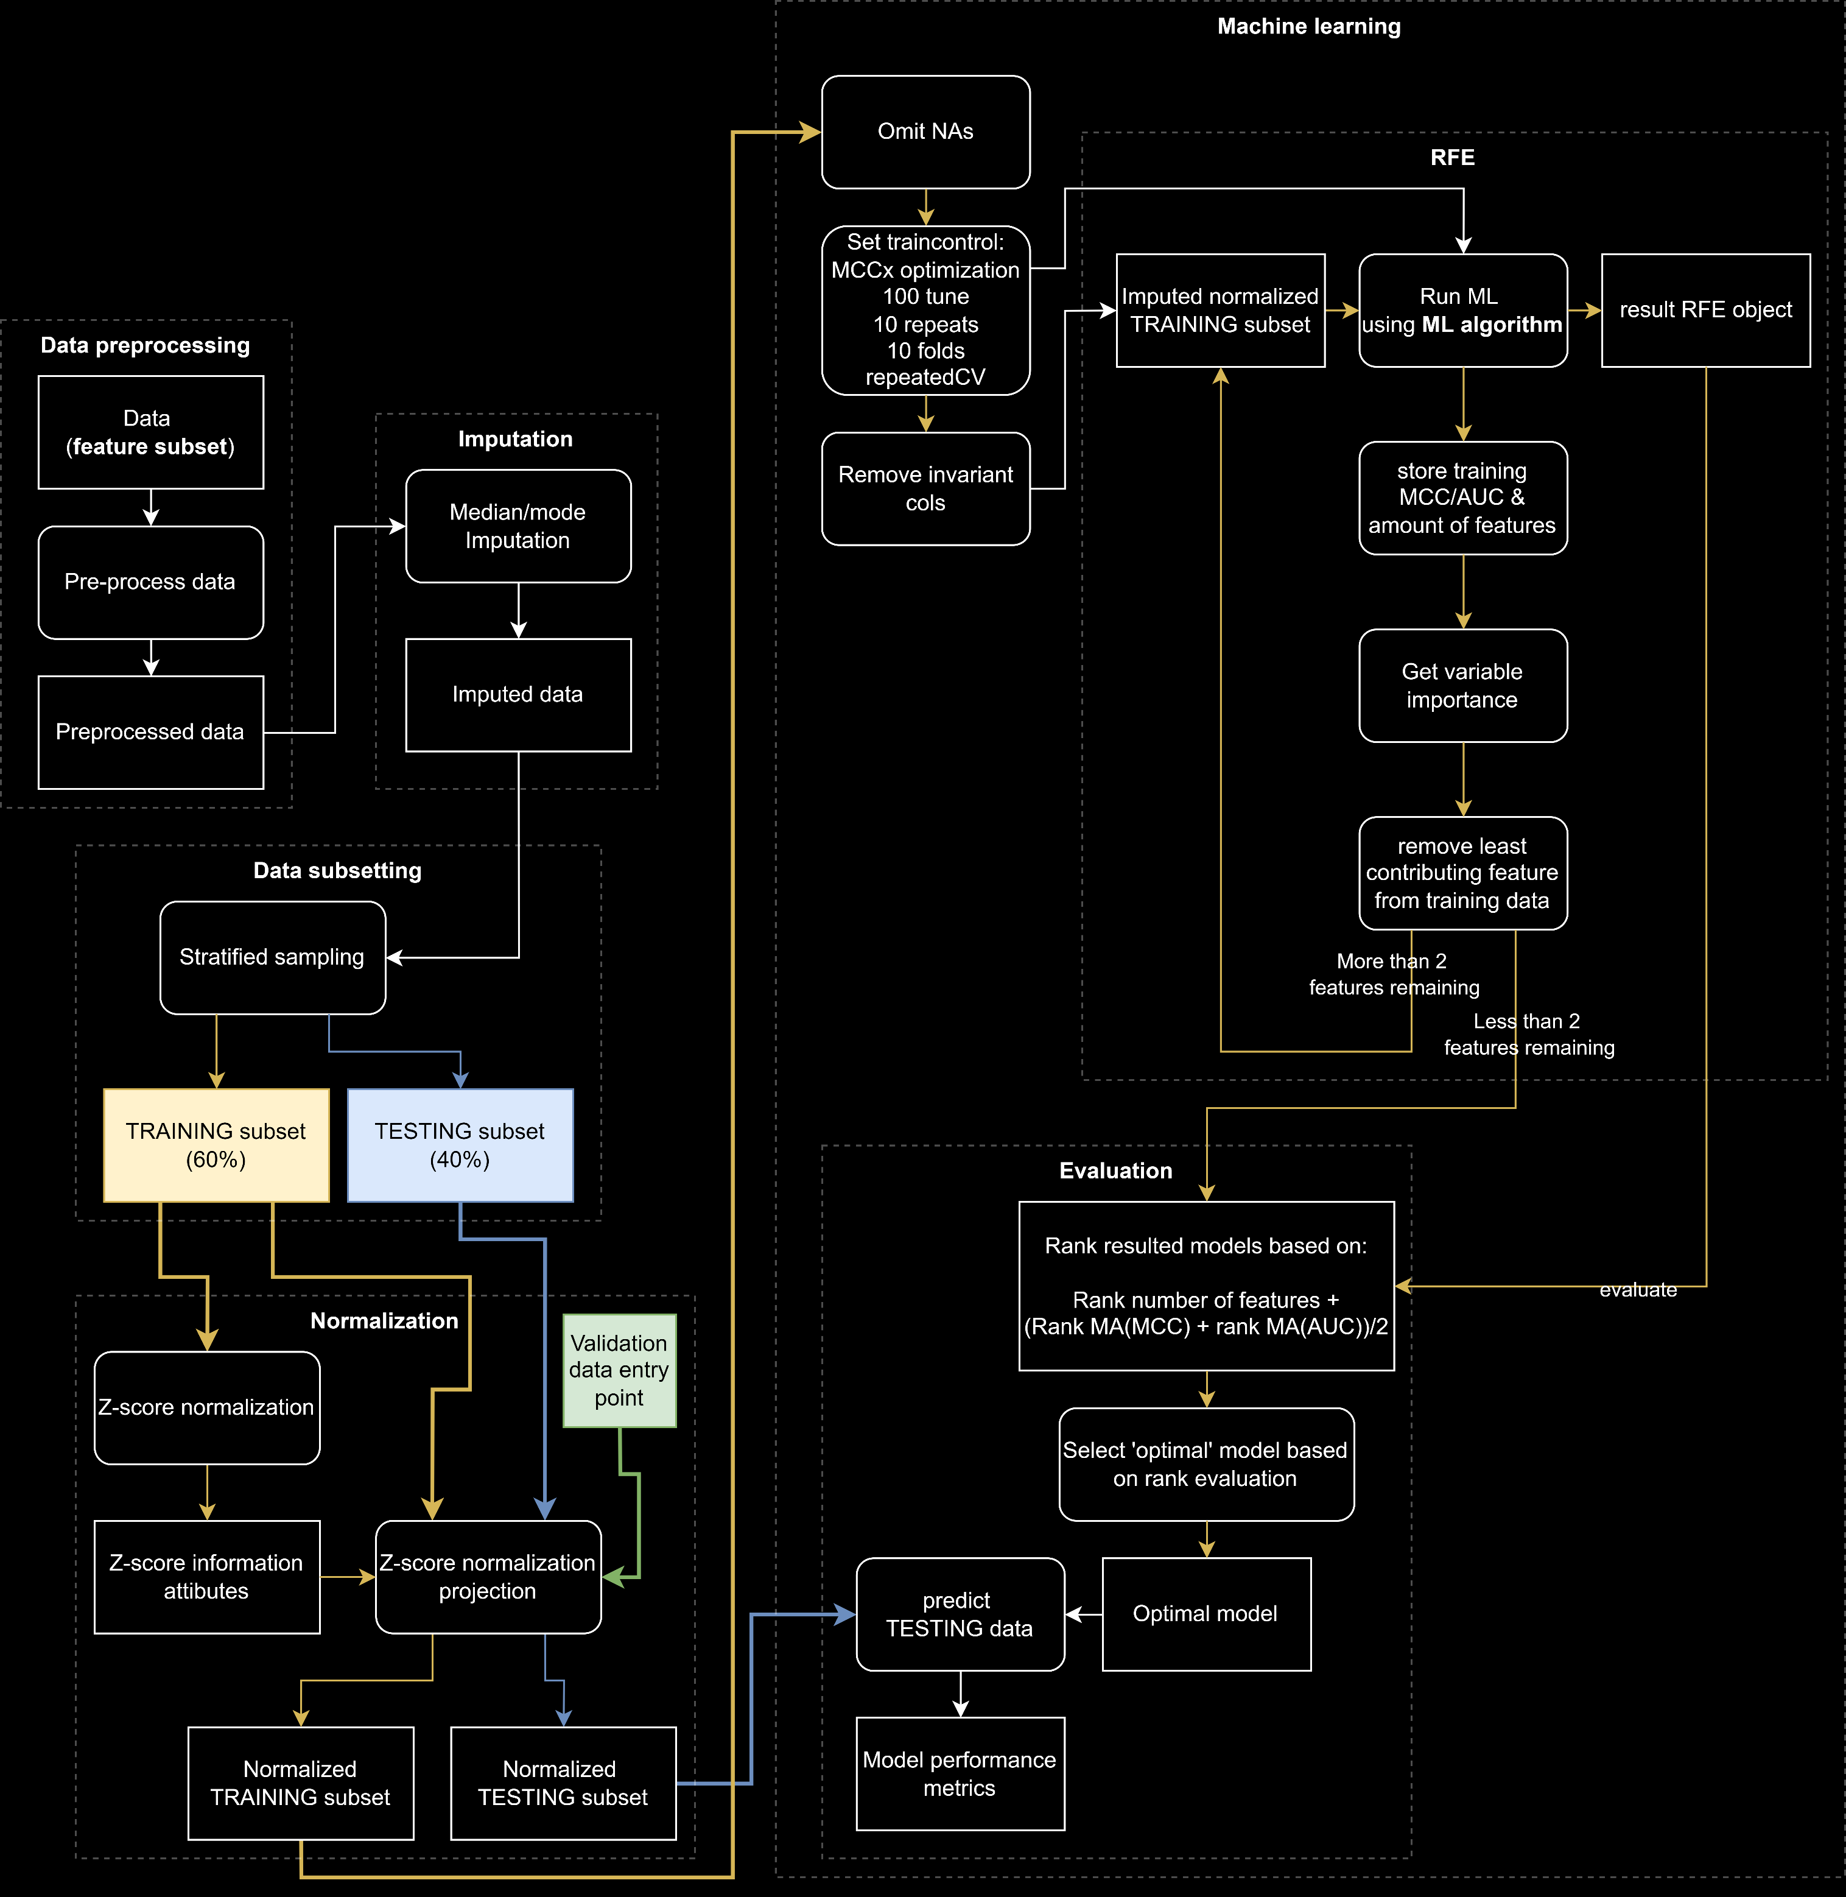
Workflow
Data preprocessing
Imputation
Data subsetting
Normalization
Machine learning
RFE
Evaluation

Slide 24
Workflow
Data preprocessing
Imputation
Data subsetting
Normalization
Machine learning
RFE
Evaluation

Slide 25
Workflow
Data preprocessing
Imputation
Data subsetting
Normalization
Machine learning
RFE
Evaluation
Outcome groups
Sex
Categorical age

Slide 26
Workflow
Data preprocessing
Imputation
Data subsetting
Normalization
Machine learning
RFE
Evaluation

Slide 27

Workflow
Data preprocessing
Imputation
Data subsetting
Normalization
Machine learning
RFE
Evaluation

Slide 28
Recursive feature elimination
Initial data
Training of model using all features
Store evaluation metrics (Performance)
Assessing feature importance
Identifying least ‘important’ feature
Remove feature from initial data
Repeat until no features able to remove

Slide 29

Recursive feature elimination
Initial data
Training of model using all features
Store evaluation metrics (Performance)
Assessing feature importance
Identifying least ‘important’ feature
Remove feature from initial data
Repeat until no features able to remove

Slide 30

Recursive feature elimination
Initial data
Training of model using all features
Store evaluation metrics (Performance)
Assessing feature importance
Identifying least ‘important’ feature
Remove feature from initial data
Repeat until no features able to remove

Slide 31

Recursive feature elimination
Initial data
Training of model using all features
Store evaluation metrics (Performance)
Assessing feature importance
Identifying least ‘important’ feature
Remove feature from initial data
Repeat until no features able to remove
Performance
# features

Slide 32

Recursive feature elimination
Initial data
Training of model using all features
Store evaluation metrics (Performance)
Assessing feature importance
Identifying least ‘important’ feature
Remove feature from initial data
Repeat until no features able to remove
Performance
# features

Slide 33
Recursive feature elimination
Initial data
Training of model using all features
Store evaluation metrics (Performance)
Assessing feature importance
Identifying least ‘important’ feature
Remove feature from initial data
Repeat until no features able to remove
Performance
# features

Slide 34

Recursive feature elimination
Initial data
Training of model using all features
Store evaluation metrics (Performance)
Assessing feature importance
Identifying least ‘important’ feature
Remove feature from initial data
Repeat until no features able to remove
Performance
# features

Slide 35
Recursive feature elimination
Initial data
Training of model using all features
Store evaluation metrics (Performance)
Assessing feature importance
Identifying least ‘important’ feature
Remove feature from initial data
Repeat until no features able to remove
Performance
# features
Multi-objective model optimization
AUC
MCC
Number of variables
Notes:
To improve the accuracy and generalizability of our models
compared to other models reported previously, we employed a
multi-objective model optimization procedure using three criteria
(AUC, MCC, and number of variables). Although AUC is commonly
used for model interpretation, it is insensitive to class imbalance.
Therefore, to prevent inaccurate prediction assessment, we
included MCC, as this metric can evaluate accuracy while
considering class balance. This, along with recursive feature
elimination (RFE)33,34 and k-fold cross-validation, further avoided
the risk of overfitting and addressed the high number of variables
included in this dataset. We applied multiple ML algorithms, to
cover a range of different learning strategies, standardly applying
RFE and multi-objective optimization for each.

Slide 36
Workflow
Data preprocessing
Imputation
Data subsetting
Normalization
Machine learning
RFE
Evaluation

Slide 37
Workflow
Data preprocessing
Imputation
Data subsetting
Normalization
Machine learning
RFE
Evaluation

Slide 38
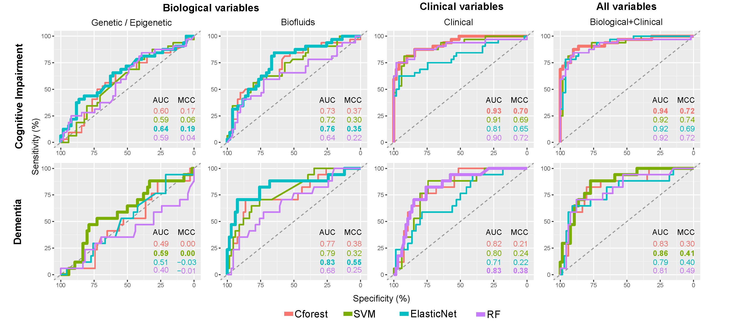
Receiver operating characteristic (ROC) plots for predicting outcomes using selected variable subsets
Notes:
In the present study, we tested the prediction of two cognitive
outcome measures in newly diagnosed PD subjects within 8 years,
using multiple variable subsets and ML algorithms. The generated
models were assessed for metrics of prediction accuracy and the
importance of contributing variables. We found that combining
both biological and clinical variables produced best performing
models, with a marginal improvement in predictive performance
compared to models using clinical variables alone. We interpret
this as evidence of synergistic contribution of multivariate data
types, producing the most accurate predictions. Of variable
subsets, the most accurate and balanced prediction was achieved
when testing for cognitive impairment (MCI and dementia
combined) using clinical data, giving the highest AUC, MCC
metrics and balance of sensitivity and specificity.

Slide 39
Receiver operating characteristic (ROC) plots for predicting outcomes using selected variable subsets
Focus on cognitive impairment outcome
Notes:
When evaluated
individually, nonclinical measures (biofluids and genetic/epigenetic)
showed poor predictive performance, regardless of outcome
tested and ML algorithm used.

Slide 40
Receiver operating characteristic (ROC) plots for predicting outcomes using selected variable subsets
Focus on clinical vs all variables
Notes:
Cognitive impairment outcome best performance

Slide 41
Receiver operating characteristic (ROC) plots for predicting outcomes using selected variable subsets
Focus on all variables
Notes:
Cognitive impairment outcome best performance

Slide 42
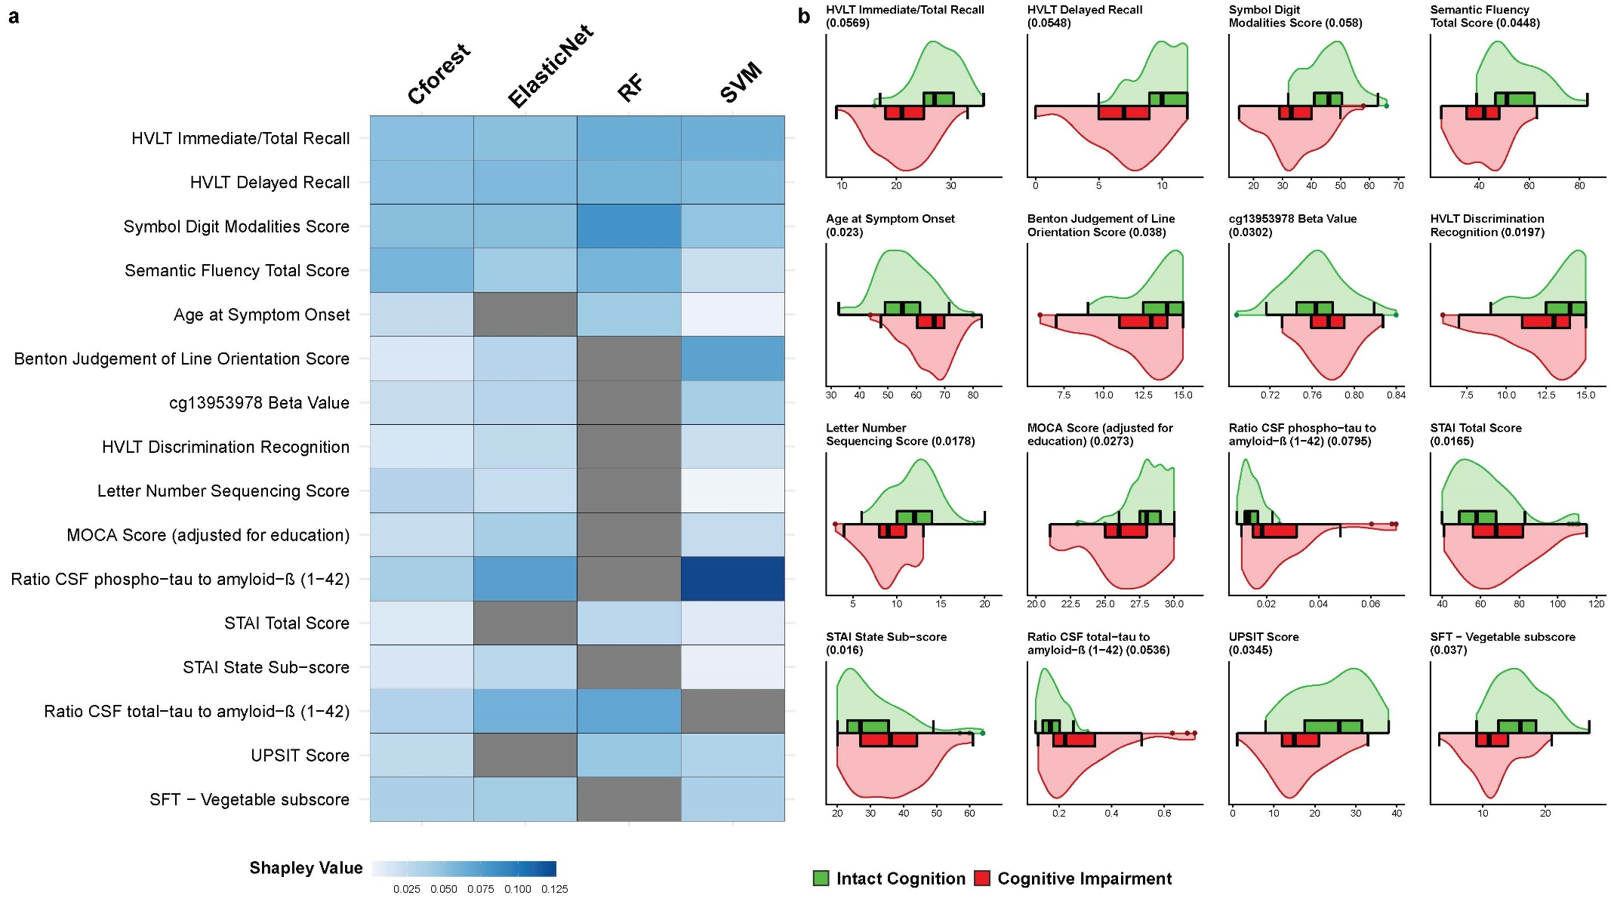
Predictive variables for cognitive impairment outcome
Notes:
Interesting findings

Slide 43
Predictive variables for cognitive impairment outcome
Cognitive variables
Notes:
Unsurprisingly a high number of contributing variables included
cognitive assessments, indicating that there was already a level of
cognitive changes present at baseline. This highlights a potential
limitation in the inclusion of these variables, as these cognitive
assessments are highly associated with the outcome of interest we
aimed to predict. However, these measures reflect an assessment
time 1–7 years before a clinically diagnosed conversion to either
MCI or dementia

Slide 44
Predictive variables for cognitive impairment outcome
Anxiety
variables
Notes:
Although anxiety is less
associated as a predictive variable for cognition within PD29, it has
been associated as a predictor of worse cognitive prognosis in
general population studies30.

Slide 45
Predictive variables for cognitive impairment outcome
Olfactory variables

Slide 46
Predictive variables for cognitive impairment outcome
DNA Methylation variables
Notes:
Additionally, one measure of blood DNA
methylation, cg13953978, was included in multiple combined
models. This locus has been previously associated with multiple
neurodegenerative diseases and, of note, we observe the same
direction of effect between cognitively impaired and preserved
individuals in this study and previously reported findings31

Slide 47
Predictive variables for cognitive impairment outcome
Amyloid-β (1-42)
variables
Notes:
Within combined models utilizing both biological and clinical
variables, ratios of CSF protein measures of total-tau, phospho-tau
and amyloid-β (1–42), had a high contributory effect across
multiple ML algorithms.

Slide 48
Discussion
Combining clinical and biological yields best accuracy
Cognitive impairment outcome best performance
Interesting findings
ML workflow

Slide 49
Considerations
Sample size
Broader applicability
DNA methylation
Neuroimaging

Slide 50
Summary
Most accurate prediction of future cognitive outcome when using both biological and clinical variables
Notes:
In summary, after evaluating multiple predictive variable types
and outcomes, we established a model that accurately predicted
cognitive impairment and preserved normal cognition over a
follow-up 8-year time span. This prediction was largely driven by
clinical measures of both known risk factors and more novel
measures, but also variably included biological variables. This work
supports evidence of anxiety and olfactory impairment as
potential predictors of cognition in PD and highlights epigenetic
measures of DNA methylation as biological predictive variables
requiring further investigation.

Slide 51
Summary
Most accurate prediction of future cognitive outcome when using both biological and clinical variables
ML models selected features previously associated with cognitive decline
Cognitive tests, age of onset, CSF protein
Notes:
In summary, after evaluating multiple predictive variable types
and outcomes, we established a model that accurately predicted
cognitive impairment and preserved normal cognition over a
follow-up 8-year time span. This prediction was largely driven by
clinical measures of both known risk factors and more novel
measures, but also variably included biological variables. This work
supports evidence of anxiety and olfactory impairment as
potential predictors of cognition in PD and highlights epigenetic
measures of DNA methylation as biological predictive variables
requiring further investigation.

Slide 52
Summary
Most accurate prediction of future cognitive outcome when using both biological and clinical variables
ML models selected features previously associated with cognitive decline
Cognitive tests, age of onset, CSF protein
Highlighted new potential predictive variables
Olfactory impairment, anxiety, DNA methylation loci
Notes:
In summary, after evaluating multiple predictive variable types
and outcomes, we established a model that accurately predicted
cognitive impairment and preserved normal cognition over a
follow-up 8-year time span. This prediction was largely driven by
clinical measures of both known risk factors and more novel
measures, but also variably included biological variables. This work
supports evidence of anxiety and olfactory impairment as
potential predictors of cognition in PD and highlights epigenetic
measures of DNA methylation as biological predictive variables
requiring further investigation.

Slide 53




Machine learning-based prediction of cognitive outcomes in de novo Parkinson’s disease Rick Reijnders
Harvey, J., Reijnders, R.A., Cavill, R. et al. Machine learning-based prediction of cognitive outcomes in de novo Parkinson’s disease. npj Parkinsons Dis. 8, 150 (2022). https://doi.org/10.1038/s41531-022-00409-5
Joshua Harvey
Dr. Ehsan Pishva
Check out the Github
Rrtk2/
PPMI-ML-Cognition-PD

Slide 54
Baseline input data
Demographic | Gender Years of Education Age at Symptom Onset Race PD Family History | Motor | Hoehn & Yahr Stage Total Rigidity Score TD/PIGD classification (OFF) Tremor Score (OFF) MDS-UPDRS Part III Score (OFF) Schwab & England ADL Score
CSF | A-beta 1-42 Alpha-synuclein t-tau p-tau Urate | Genetic | APOE Genotype MAPT haplotype SNCA rs356181 genotype SNCA rs3910105 genotype rs12411216 genotype Parkinson's Disease PRS Alzheimer's Disease PRS Educational Attainment PRS Depression PRS Schizophrenia PRS GBA mutation status
Cognitive | MDS-UPDRS Part I Score BJLO HVLT LNS Score Semantic Fluency Total Score MOCA SDM Score
 |  | Other | UPSIT Score Epworth Sleepiness Scale QUIP disorder REM Sleep Behavior Disorder SCOPA-AUT
Epigenetic | 21 CpG Beta Values 4 Age Acceleration Measures Smoking Score
Psychiatric | GDS Score STAI Total Score

Slide 55
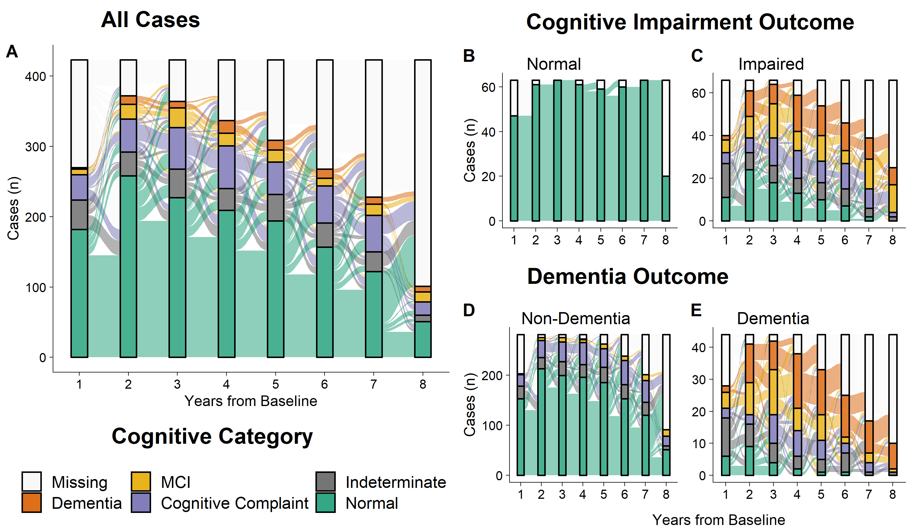
Subsetting cognitive outcome groups

Slide 56
Curating Baseline Measures
Clinical
Demographic:
Age, Sex, Years of
Education, Ethnicity,
Family History
Psychiatric:
Geriatric Depression,
State Trait Anxiety
Cognitive:
MDS-UPDRS I, BJLO,
HVLT, LNS, Semantic
Fluency, MOCA, SDM
Motor:
TD/ PIGD Subtype,
H&Y, MDS-UPDRS III,
Schwab & England ADL
Other:
UPSIT Olfactory,
Epworth Sleepiness,
QUIP Impulse,
REM- Sleep Behavior
Disorder, SCOPA-Autonomic
Biofluid
CSF:
A-beta 1-42
Alpha-synuclein
Total-tau
Phospho-tau
Blood:
Urate
Risk genotypes:
APO-E
SNCA
GBA
MAPT
Polygenic Scores:
Alzheimer’s Disease
PD
Schizophrenia
Depression
Educational Attainment
Epigenetic:
21 DNA methylation values
4 Age Acceleration Measures
Smoking Score
(Epi)genetic

Slide 57
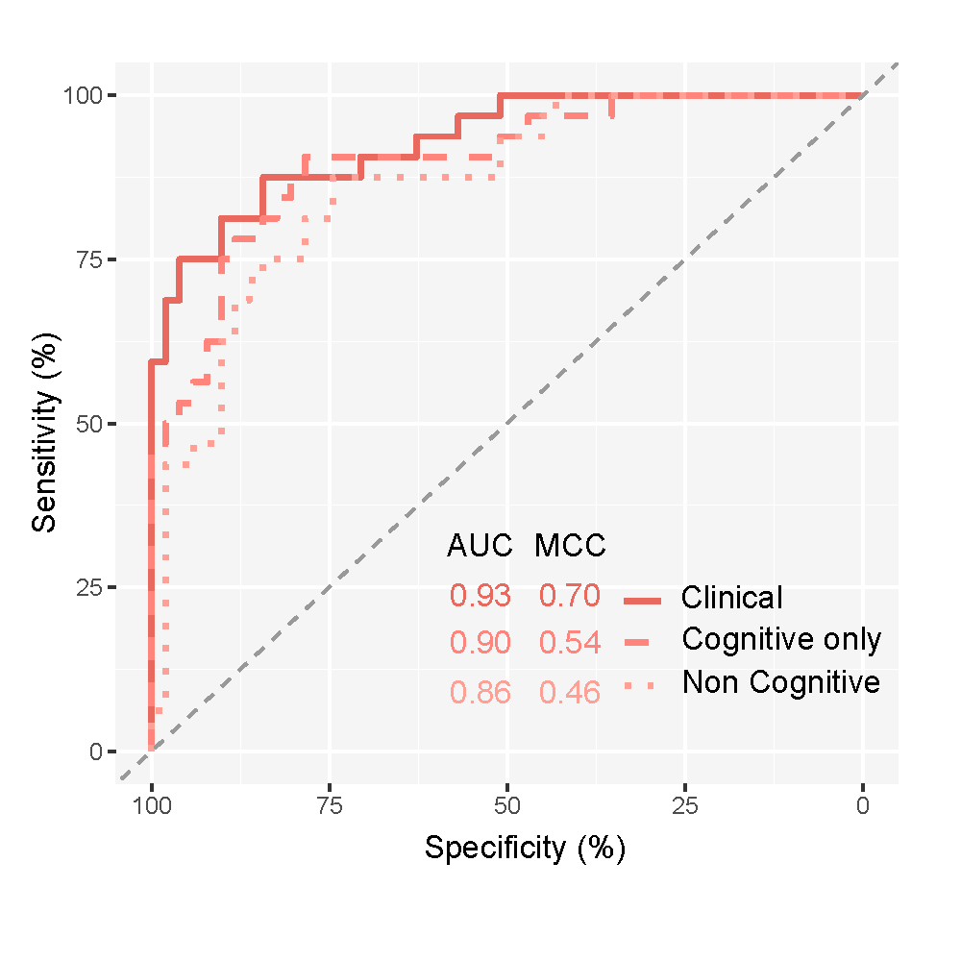
The effect of cognitive tests in predictive accuracy
Algorithm
Cforest
Variable subsets
Clinical (all)
Cognitive only
Non-cognitive only
Notes:
Sensitivity analysis of the effect of cognitive
variables in prediction confirmed that cognitive variables had a
large contributory effect to predictions although increased
sensitivity was observed with the inclusion of noncognitive clinical
variables. Top contributing noncognitive variables included age at
onset of PD, anxiety, and olfactory impairment. Older age of PD
onset, which we observe within the cognitive decline group, is a
well-established and validated risk factor for PD-cognitive
decline4. Olfactory impairment has been increasingly associated
with cognitive impairment in PD25–28. Although anxiety is less
associated as a predictive variable for cognition within PD29, it has
been associated as a predictor of worse cognitive prognosis in
general population studies30

Slide 58
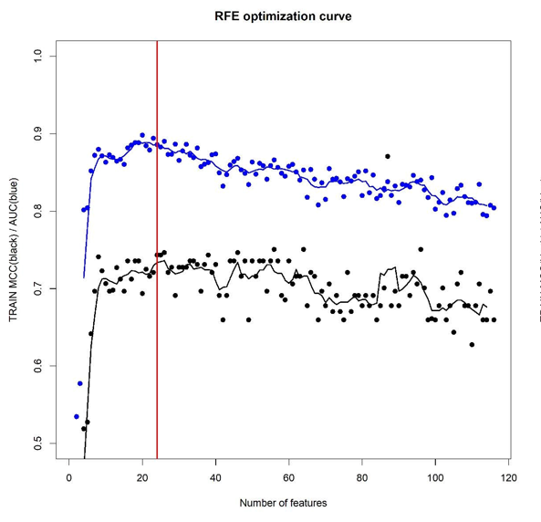
Recursive feature elimination
AUC
MCC

Slide 59
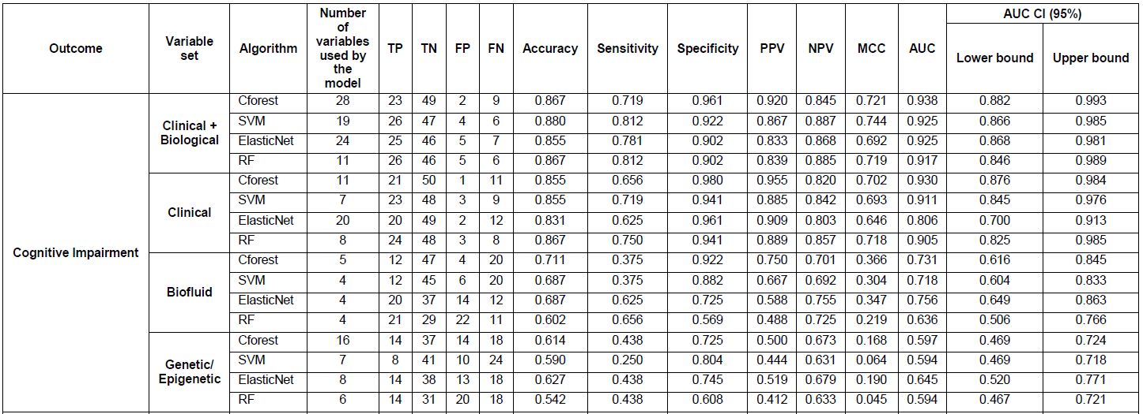
ML metrics

Slide 60
Receiver operating characteristic (ROC) plots for predicting outcomes using selected variable subsets
Potential timesaver
Focus on overall prediction of outcomes
Notes:
Combining clinical and biological yields best accuracy
Comparing outcomes, prediction of combined cognitive impairment,
merging cases developing either MCI or dementia,
consistently outperformed dementia conversion alone, which we
interpret as being driven by poor differentiation of MCI individuals
when predicting dementia conversion. Indeed, models tested to
stratify MCI from dementia cases performed poorly with low
specificity of predictions. MCI is a well-established risk factor for
future dementia development4, and previous studies show higher
dropout within PPMI is associated with worse cognitive performance24.
Given this, the overall progression profile of MCI and
dementia, as subsets within this study, might not differ
substantially, with MCI patients potentially converting to dementia
in unobserved events. This further supports the use of a combined
cognitive impairment group, with best prediction being observed
for this outcome

